Slide 1
Random Dungeon Explorers
Le hasard est l’unique Maître du Donjon !

Slide 2
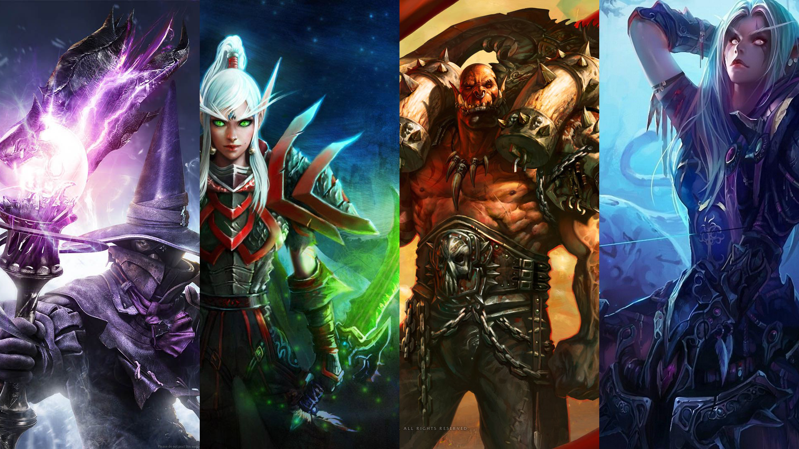
Incarnez un personnage
Choisissez votre classe parmi les 4 disponibles: Mage, Assassin, Guerrier et Chasseur

Slide 3
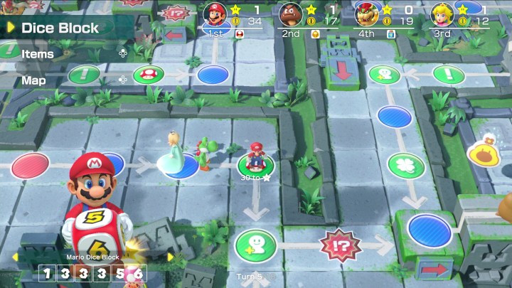
Un donjon semé d’embûches !
Trouver un trésor, tomber dans un piège, seuls les dés peuvent le décider…

Slide 4
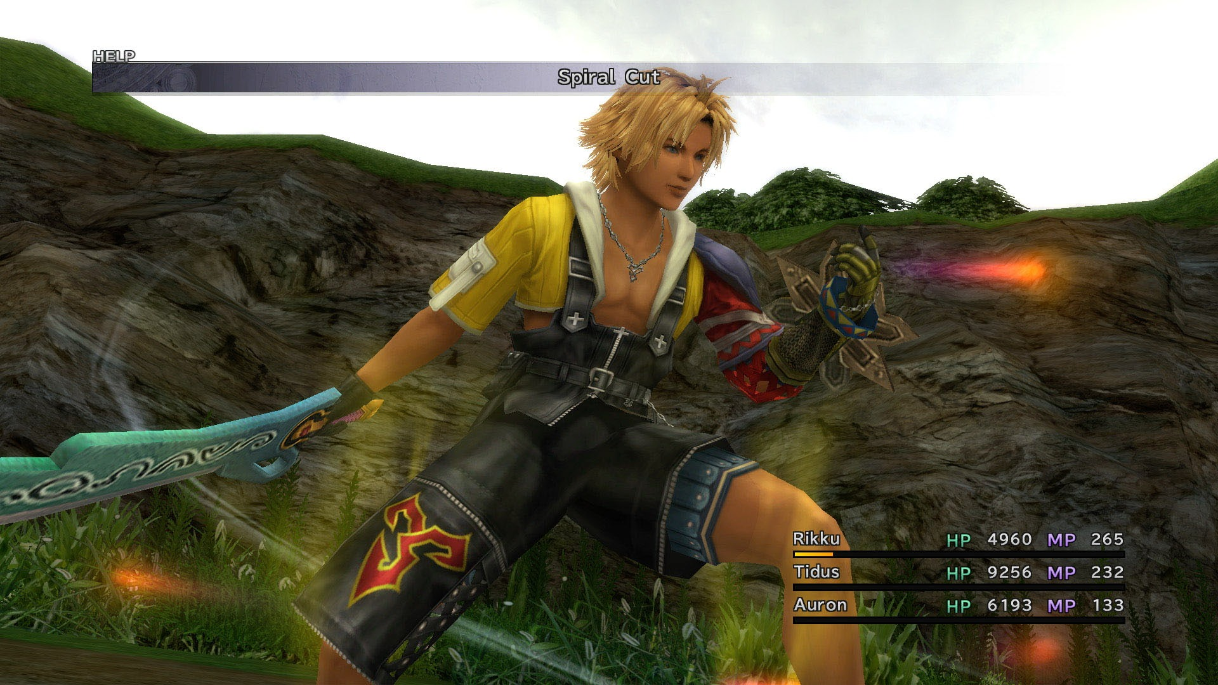
Faites progresser votre héros !
Affrontez les monstres du donjon pour améliorer les compétences de votre héros

Slide 5
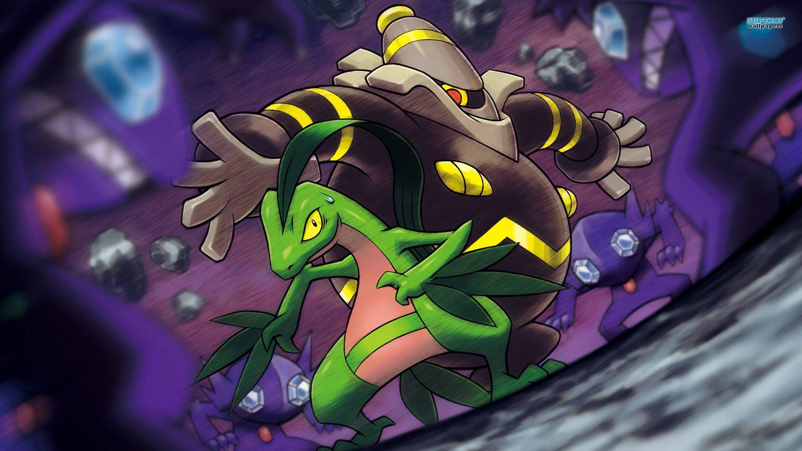
Une expérience unique à chaque partie !
Chaque donjon est généré aléatoirement, permettant une re-jouabilité presque infinie

Slide 6
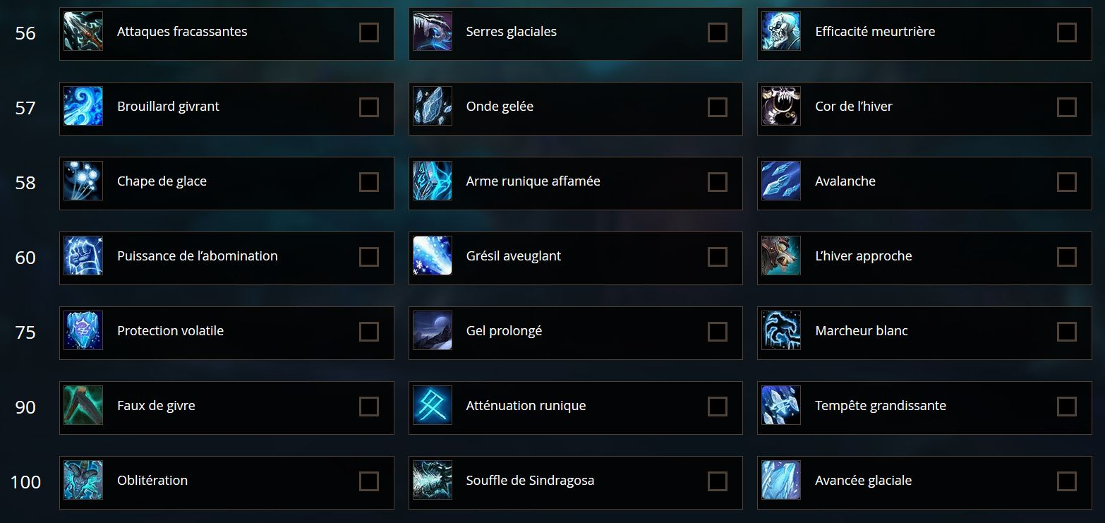
Développez vos compétences !
Obtenez de nouveaux pouvoirs grâce à l’arbre de talent de votre personnage

Slide 7
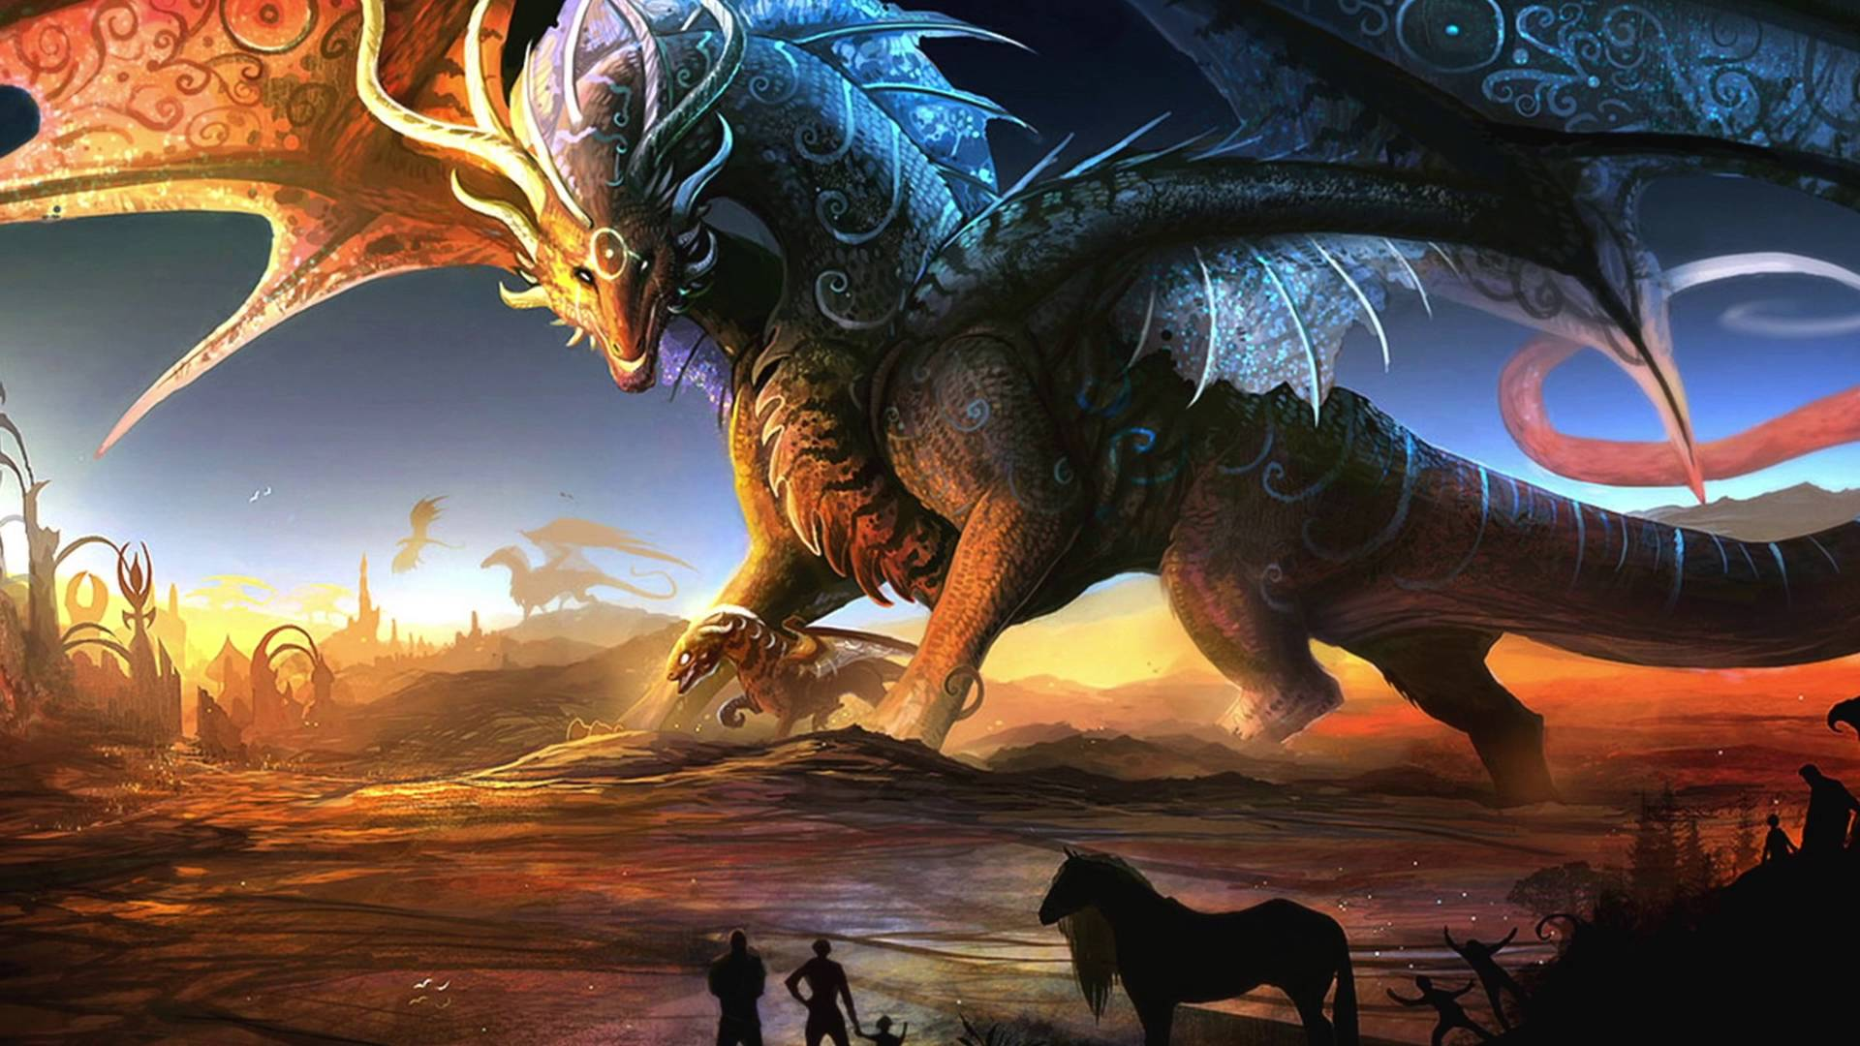
Terrassez les nombreux boss !
Tuez les serviteurs du néant et venez à bout de Ven’Quarr, le Corrupteur du Temps

Slide 8
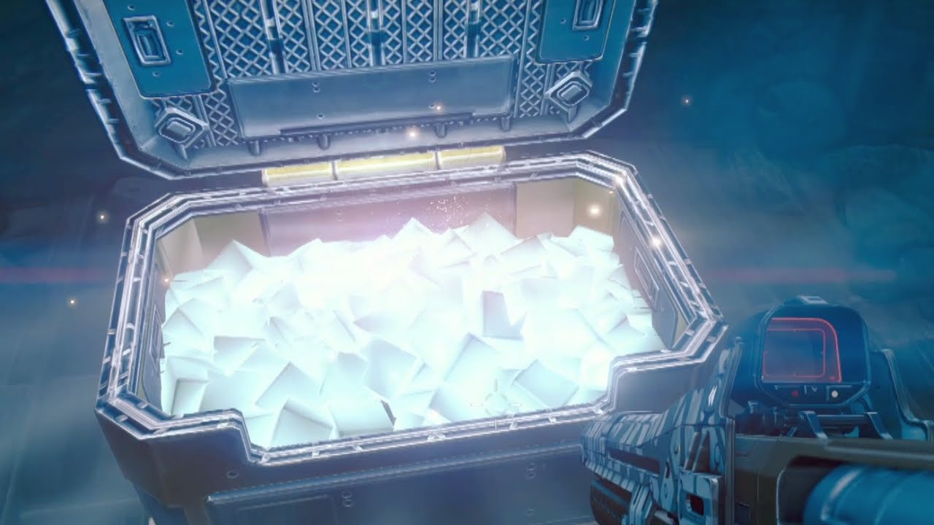
Amassez du butin !
Trouvez les trésors dans le donjon qui vous permettront de booster les caractéristiques de votre héros

Slide 9
Merci !
Questions ?

Slide 10
Instructions for use
EDIT IN GOOGLE SLIDES
Click on the button under the presentation preview that says "Use as Google Slides Theme".
You will get a copy of this document on your Google Drive and will be able to edit, add or delete slides.
You have to be signed in to your Google account.
EDIT IN POWERPOINT®
Click on the button under the presentation preview that says "Download as PowerPoint template". You will get a .pptx file that you can edit in PowerPoint.
Remember to download and install the fonts used in this presentation (you’ll find the links to the font files needed in the Presentation design slide)
More info on how to use this template at www.slidescarnival.com/help-use-presentation-template
This template is free to use under Creative Commons Attribution license. You can keep the Credits slide or mention SlidesCarnival and other resources used in a slide footer.

Slide 11
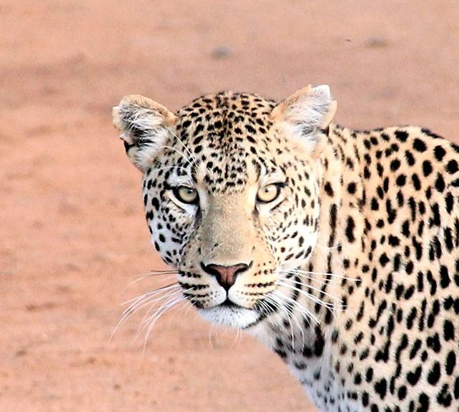
Hello!
I am Jayden Smith
I am here because I love to give presentations.
You can find me at @username

Slide 12
Transition headline
1
Let’s start with the first set of slides

Slide 13
Quotations are commonly printed as a means of inspiration and to invoke philosophical thoughts from the reader.

Slide 14
This is a slide title
Here you have a list of items
And some text
But remember not to overload your slides with content
Your audience will listen to you or read the content, but won’t do both.

Slide 15
BIG concept
Bring the attention of your audience over a key concept using icons or illustrations

Slide 16
You can also split your content
White
Is the color of milk and fresh snow, the color produced by the combination of all the colors of the visible spectrum.
Black
Is the color of coal, ebony, and of outer space. It is the darkest color, the result of the absence of or complete absorption of light.

Slide 17
In two or three columns
Yellow
Is the color of gold, butter and ripe lemons. In the spectrum of visible light, yellow is found between green and orange.
Blue
Is the colour of the clear sky and the deep sea. It is located between violet and green on the optical spectrum.
Red
Is the color of blood, and because of this it has historically been associated with sacrifice, danger and courage.

Slide 18
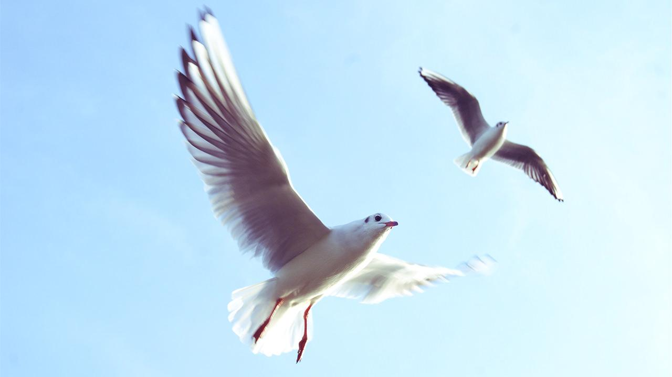
Want big impact?
Use big image.

Slide 19
Use charts to explain your ideas
White
Gray
Black

Slide 20
And tables to compare data
 | A | B | C
Yellow | 10 | 20 | 7
Blue | 30 | 15 | 10
Orange | 5 | 24 | 16

Slide 21
Maps
our office

Slide 22
89,526,124
Whoa! That’s a big number, aren’t you proud?

Slide 23
89,526,124$
185,244 users
100%
That’s a lot of money
And a lot of users
Total success!

Slide 24
Our process is easy
first
second
last

Slide 25
Our sales funnel
20%
40%
60%
80%
Diagram featured by http://slidemodel.com
100%

Slide 26
Let’s review some concepts
Yellow
Is the color of gold, butter and ripe lemons. In the spectrum of visible light, yellow is found between green and orange.
Blue
Is the colour of the clear sky and the deep sea. It is located between violet and green on the optical spectrum.
Red
Is the color of blood, and because of this it has historically been associated with sacrifice, danger and courage.
Yellow
Is the color of gold, butter and ripe lemons. In the spectrum of visible light, yellow is found between green and orange.
Blue
Is the colour of the clear sky and the deep sea. It is located between violet and green on the optical spectrum.
Red
Is the color of blood, and because of this it has historically been associated with sacrifice, danger and courage.

Slide 27
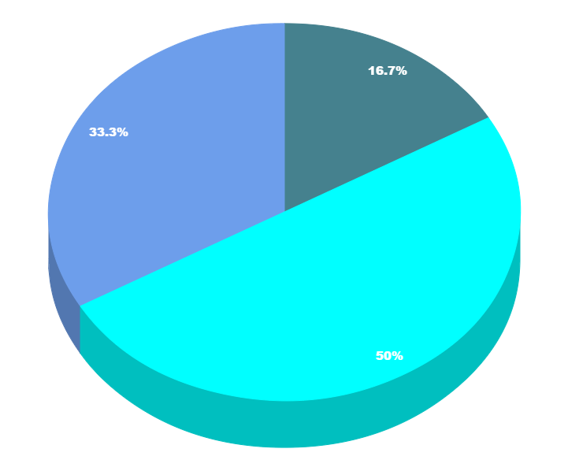
You can copy&paste graphs from Google Sheets

Slide 28
Place your screenshot here
Android project
Show and explain your web, app or software projects using these gadget templates.

Slide 29
Place your screenshot here
iPhone project
Show and explain your web, app or software projects using these gadget templates.

Slide 30
Place your screenshot here
Tablet project
Show and explain your web, app or software projects using these gadget templates.

Slide 31
Place your screenshot here
Desktop project
Show and explain your web, app or software projects using these gadget templates.

Slide 32
Credits
Special thanks to all the people who made and released these awesome resources for free:
Presentation template by SlidesCarnival
Photographs by Unsplash

Slide 33
Presentation design
This presentation uses the following typographies and colors:
Titles: Nixie One
Body copy: Muli
You can download the fonts on this page:
https://www.fontsquirrel.com/fonts/nixie-one
https://www.fontsquirrel.com/fonts/muli
Aquamarina #00e1c6 / Turquoise #19bbd5 / Skyblue #2c9dde /
Light gray #c6daec / Dark blue #0e293c
You don’t need to keep this slide in your presentation. It’s only here to serve you as a design guide if you need to create new slides or download the fonts to edit the presentation in PowerPoint®

Slide 34
SlidesCarnival icons are editable shapes.
This means that you can:
Resize them without losing quality.
Change fill color and opacity.
Change line color, width and style.
Isn’t that nice? :)
Examples:

Slide 35
😉
Now you can use any emoji as an icon!
And of course it resizes without losing quality and you can change the color.
How? Follow Google instructions https://twitter.com/googledocs/status/730087240156643328
✋👆👉👍👤👦👧👨👩👪💃🏃💑❤😂😉😋😒😭👶😸🐟🍒🍔💣📌📖🔨🎃🎈🎨🏈🏰🌏🔌🔑 and many more...

